Slide 1
Multi Agent AI Systems
HasGeek
The Fifth Elephant
Mayur Madnani

Slide 2

Who Am I?
Staff Engg @ JioHotstar
Previously @ Intuit, Walmart, SAP
Expertise in Data, AI and Backend
~10 years in the Industry
GenAI Course Author
Speaker & Mentor
Mayur Madnani

Slide 3
AI Evolution
ERA 1
ERA 2
ERA 3
ERA 4
Rules-Based AI
Deterministic logic
Hand-crafted, predefined rules
Task-specific automation
Minimal adaptability and learning
Machine Learning
Learns patterns from data
Statistical modeling and optimization
Prediction and classification
Improves performance with experience
Generative AI
Creates text, images, code, and media
Trained on large-scale data
Context-aware and conversational
Produces human-like outputs
Agentic AI
Autonomous
Interacts with tools and environments
Continuously learns and adapts
Perceive - Reason - Act - Learn
https://ourworldindata.org/brief-history-of-ai
https://r0bk.github.io/killedbyllm/

Slide 4
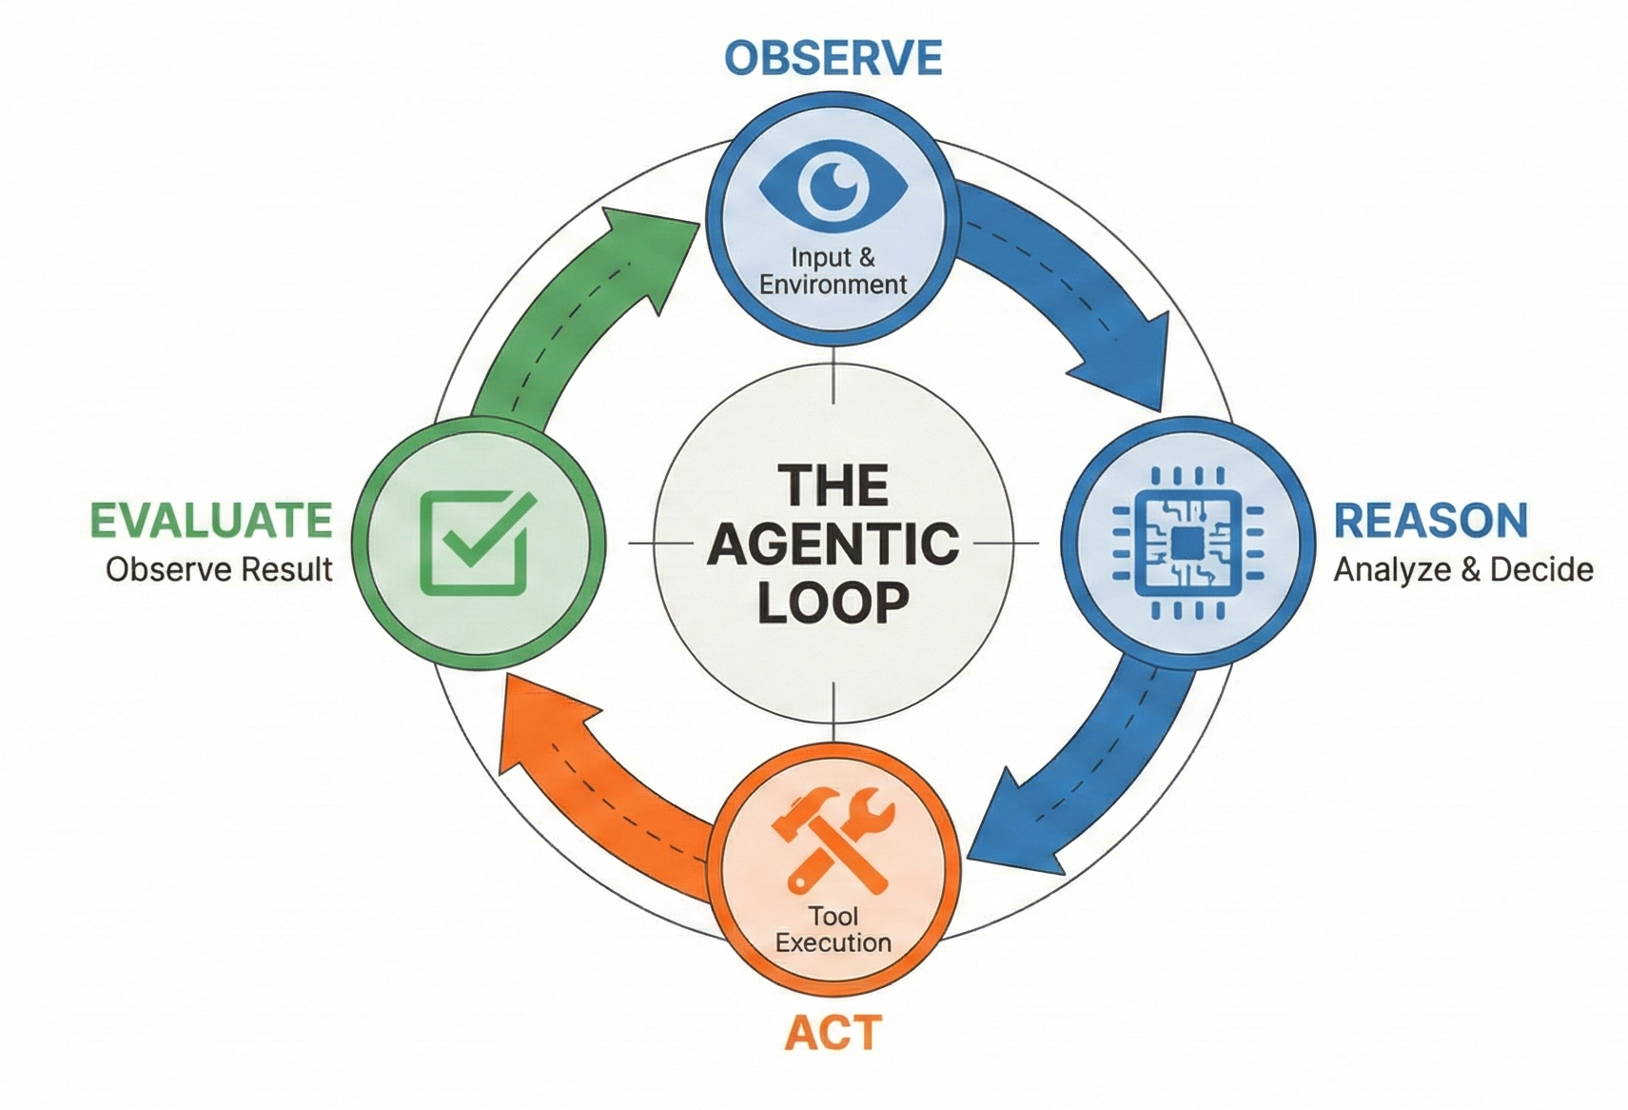
What is Agentic AI?
Agentic AI systems are LLM-powered systems that can autonomously reason, plan, take actions, observe outcomes, and iterate toward a goal.
Key distinction from traditional LLM usage:
LLM Prompting: Single-shot input → output
Agentic Systems: Continuous loop over time

Slide 5
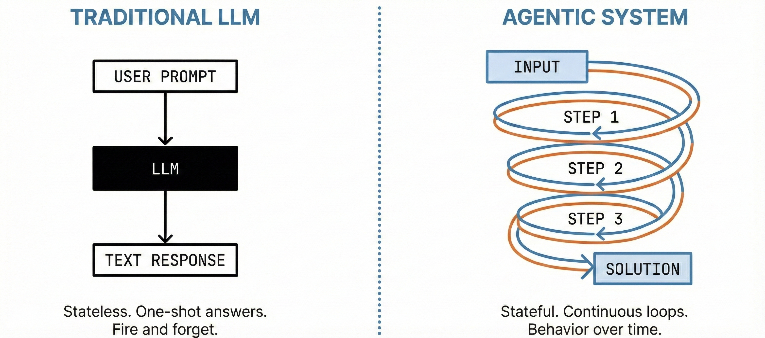
From "Stateless Chat" to "Stateful Loops"
The Brain (LLM)
The Hands (Tools)
The Memory (State)
Agents are not smarter models — they are better-orchestrated workflows

Slide 6
Why Multi-Agent?
https://arxiv.org/abs/2506.02153
https://arxiv.org/abs/2511.18258
https://blog.langchain.com/benchmarking-multi-agent-architectures/
https://microsoft.ai/news/the-path-to-medical-superintelligence/

Slide 7
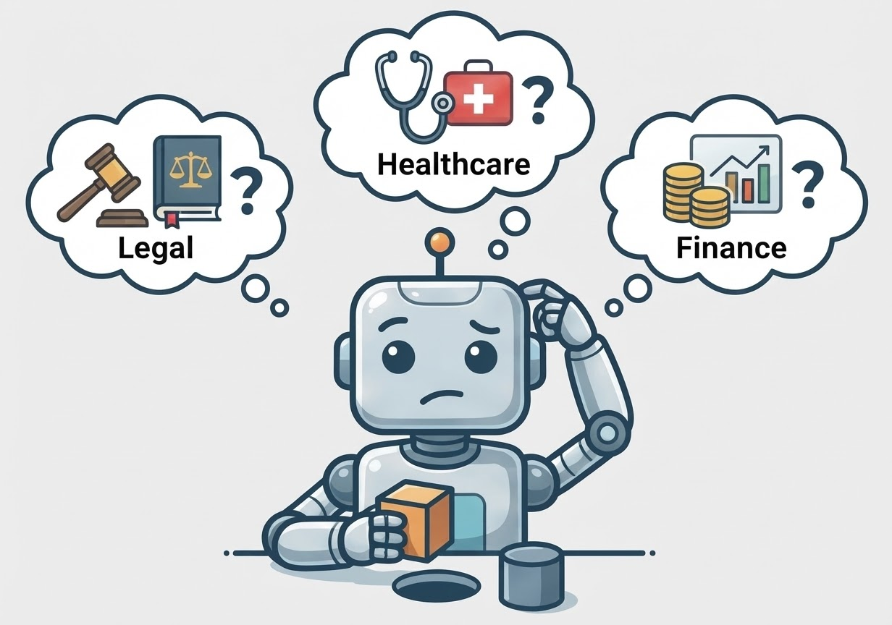
The “Generalist” Problem

Slide 8
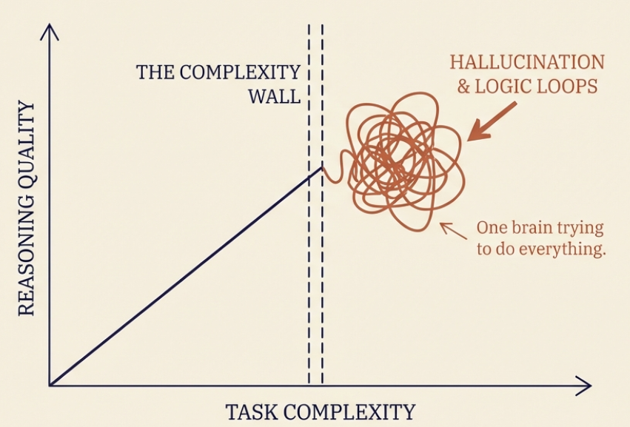
The “Generalist” Problem

Slide 9
LLMs / SLMs
Large Language Models (LLMs)
Small Language Models (SLMs)
Massive Scale
Knowledge Transfer
Deep Architecture
Compact Architecture
Versatile
Precision focused
Resource Intensive
Agentic & privacy focus
Performance
Domain specialist

Slide 10
LLMs / SLMs
Feature | LLM | SLM
Philosophy | One model to rule them all | Right tool for the right job
Scale | Massive parameters (100B+) | Compact & Efficient (<10B)
Focus | General purpose versatility | Domain precision & Agentic workflows
Resources | Requires data center clusters | Runs on consumer GPUs/edge devices
Outcome | Raw Knowledge Capability | Privacy, Speed, and ROI

Slide 11
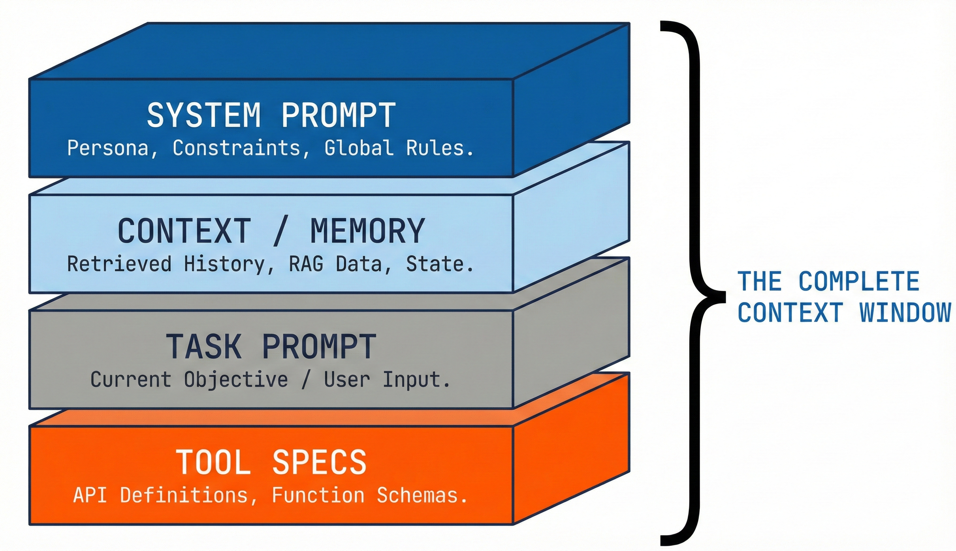
Prompts as behaviour controllers

Slide 12
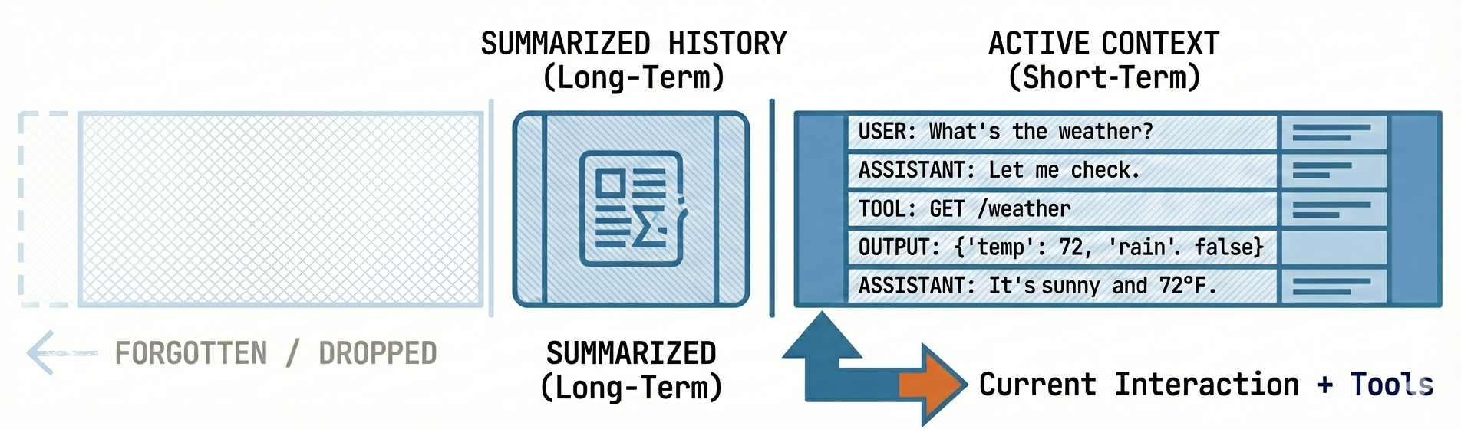
Context Management

Slide 13
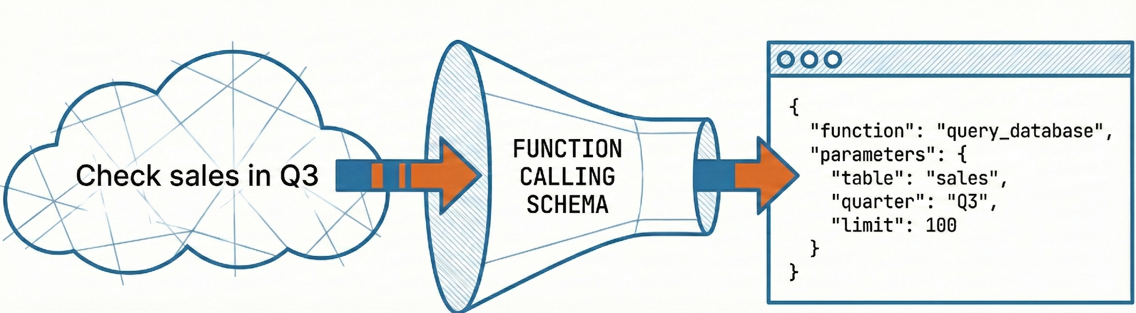
Reliability
Function calling:
Forces structured outputs
Reduces hallucination
Enables deterministic execution
Best used for: APIs, DB queries, State updates
Prompting shifts from "what to say" to "what function to call“
Evals
Agents are non-deterministic and Manual testing doesn’t scale
Eval dimensions: Task success, Tool correctness, Latency, Cost, Failure rate
Use: Golden datasets, Regression evals, Behaviour-based scoring
Guardrails & constraints
Structured outputs

Slide 14
Role-based prompting
Role
+
Persona
+
Tone
+
Expertise
A strong role includes:
Who the agent is
What it is optimizing for
What it must avoid
Role-based prompting:
Narrows solution space
Activates domain-relevant priors
Improves consistency

Slide 15
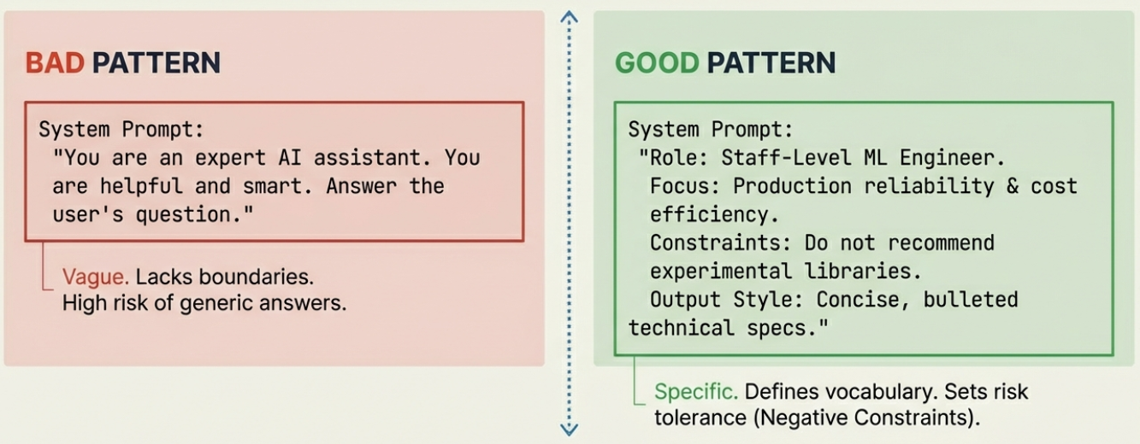
Role-based prompting
Role
+
Persona
+
Tone
+
Expertise
A strong persona defines what the agent is optimizing for AND what it must avoid

Slide 16
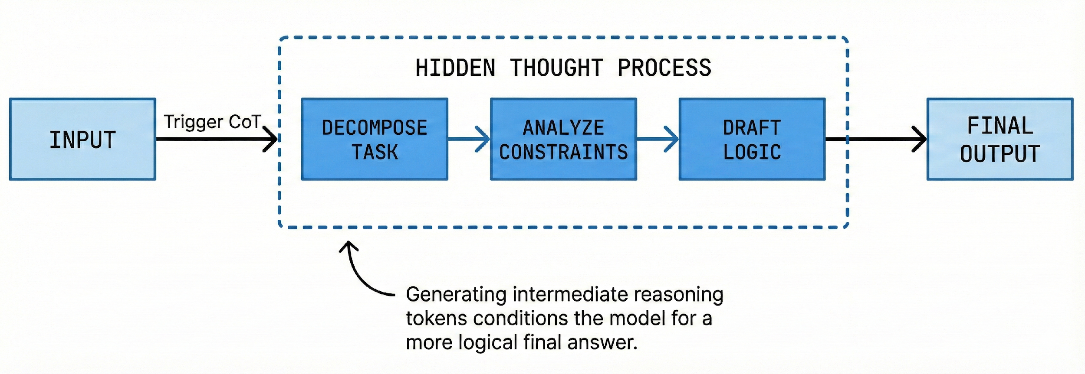
CoT: Chain of Thought

Slide 17
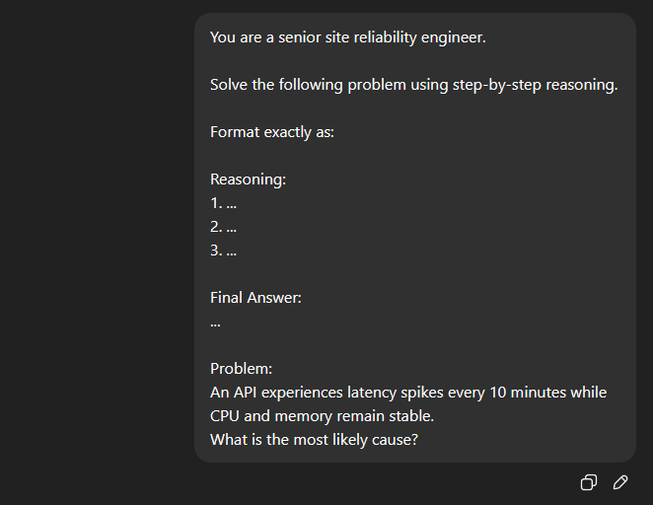
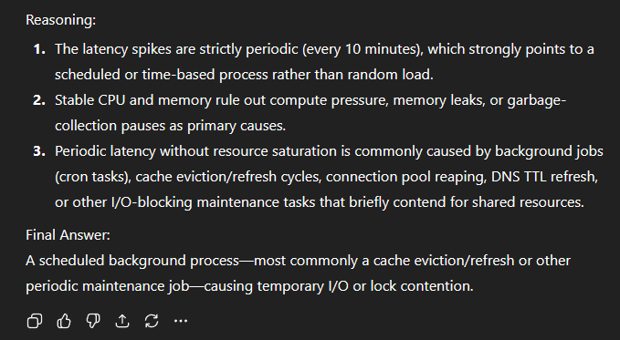
CoT: Chain of Thought

Slide 18
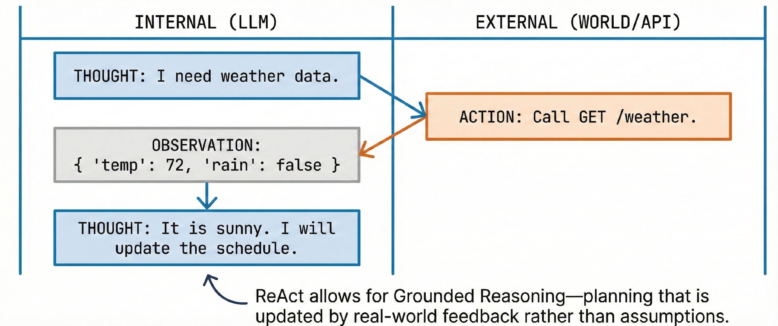
ReAct: Reason, Act,Observe

Slide 19
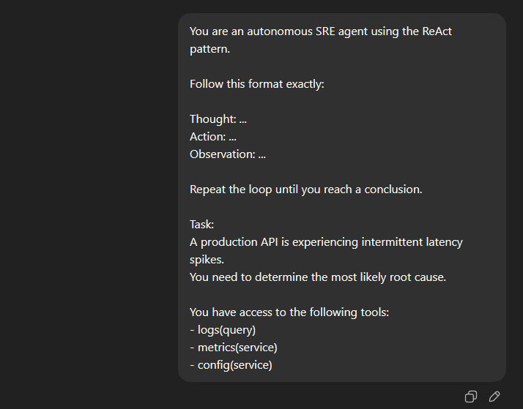
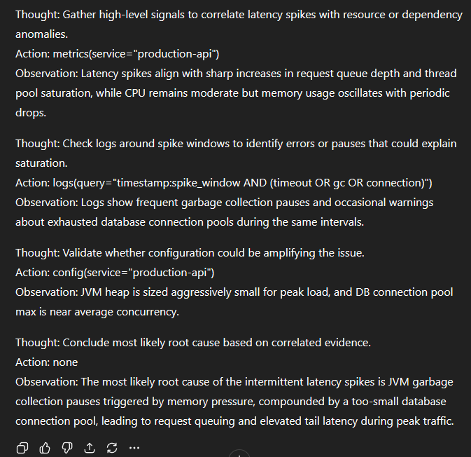
ReAct: Reason, Act,Observe

Slide 20
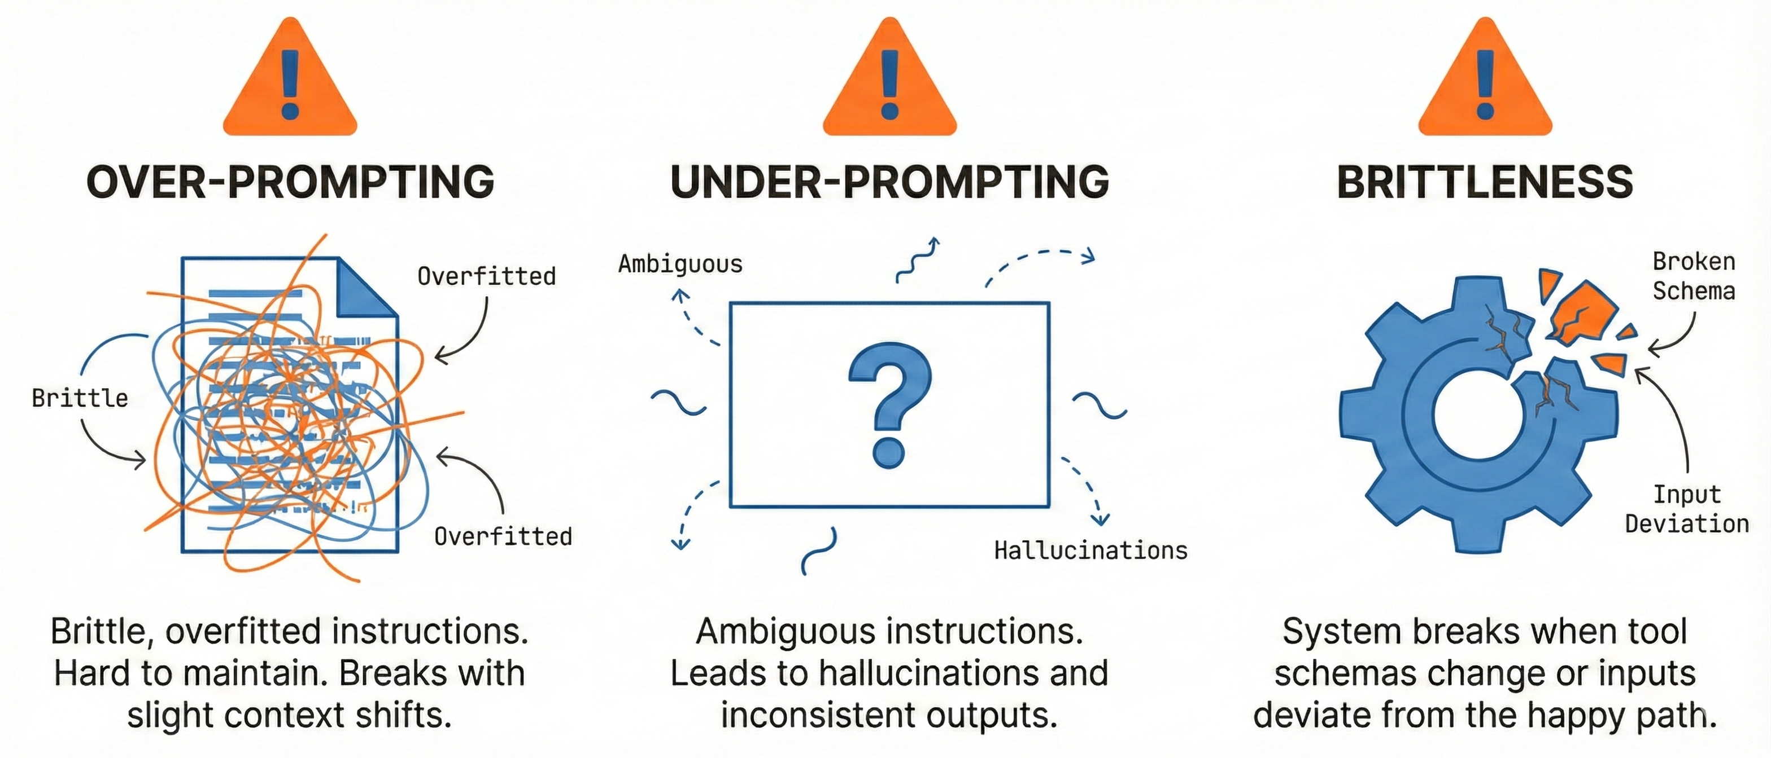
How much to prompt?
Modular prompts, Clear contracts, Evals

Slide 21
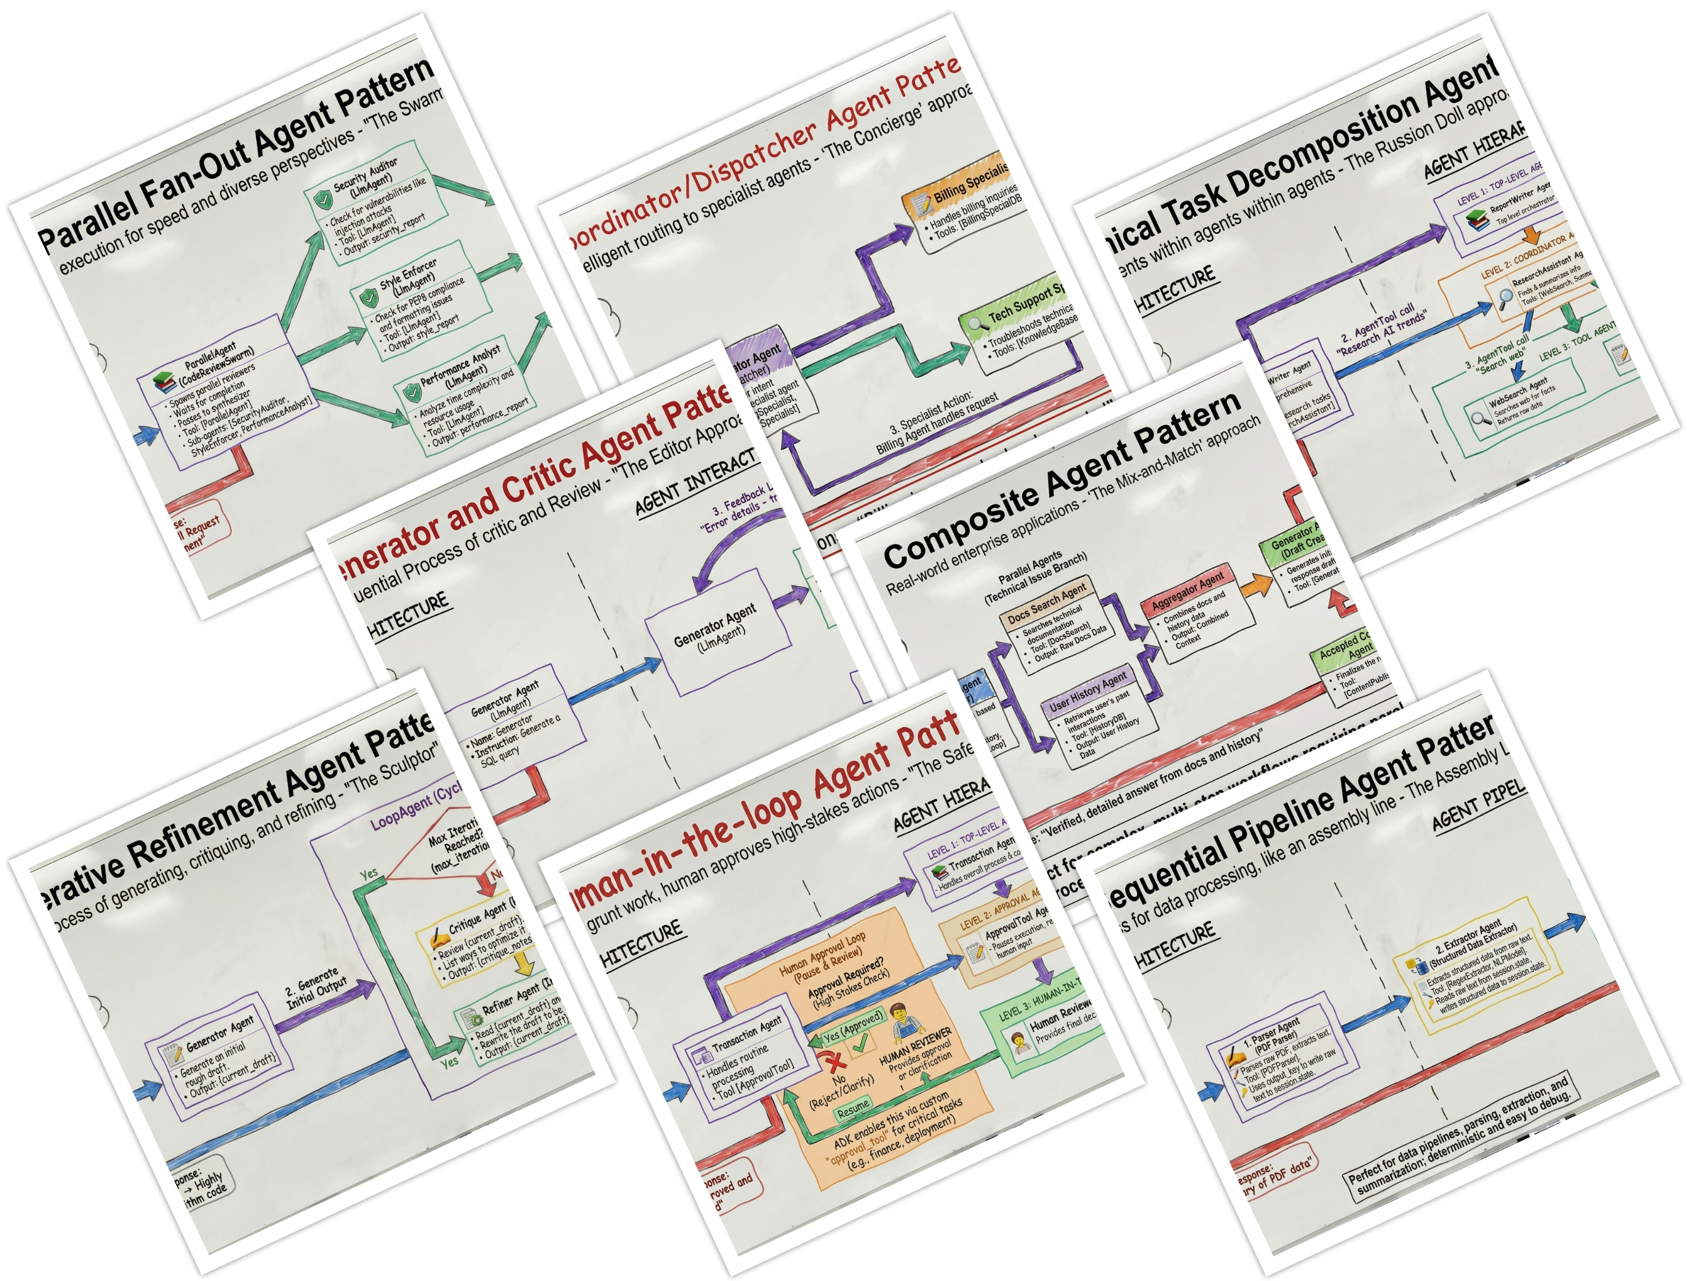
Multi-Agent Design Patterns
https://developers.googleblog.com/developers-guide-to-multi-agent-patterns-in-adk/

Slide 22
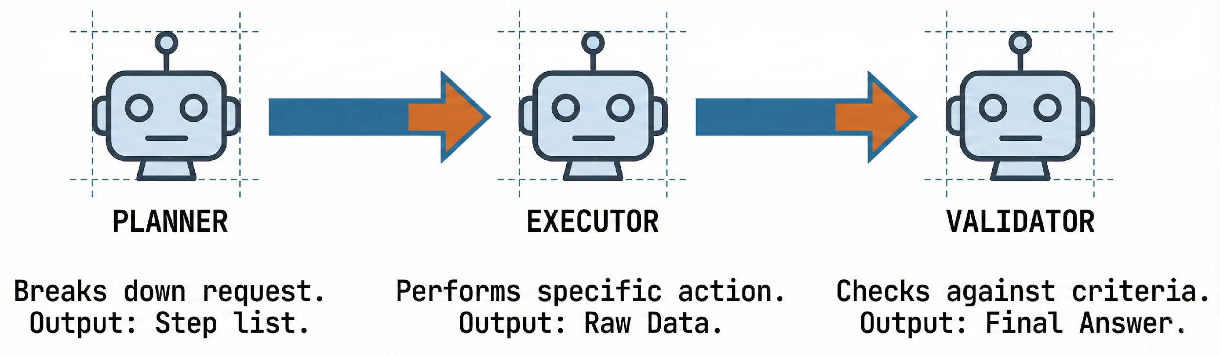
Prompt chaining
Break complex tasks into:
Planner prompt
Executor prompt
Validator prompt
Benefits:
Easier debugging
Higher reliability
Agents are not smarter models — they are better-orchestrated workflows

Slide 23
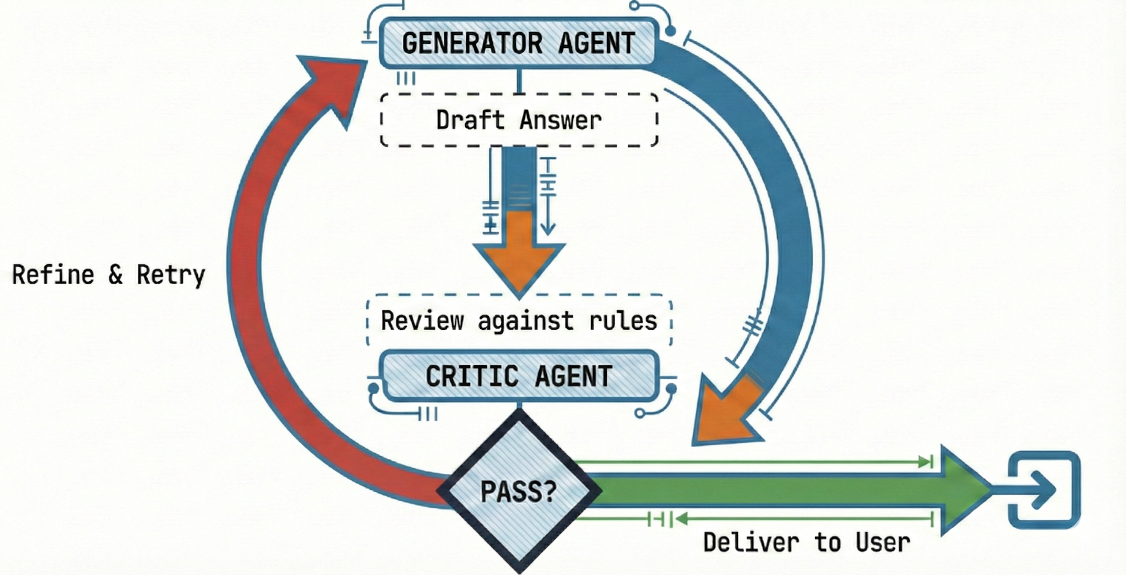
Feedback loops
Agents can:
Critique their own output
Retry failed steps
Improve answers iteratively
Common patterns:
Self-reflection
Critic agent
Retry-on-failure

Slide 24
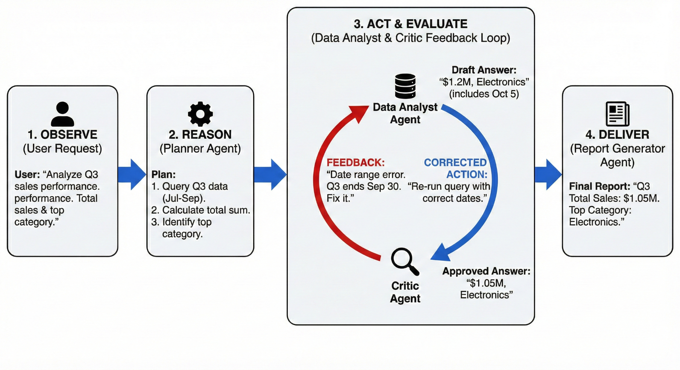
Example: Data Analysis Agentic System

Slide 25
WORKSHOP TIME

Slide 26
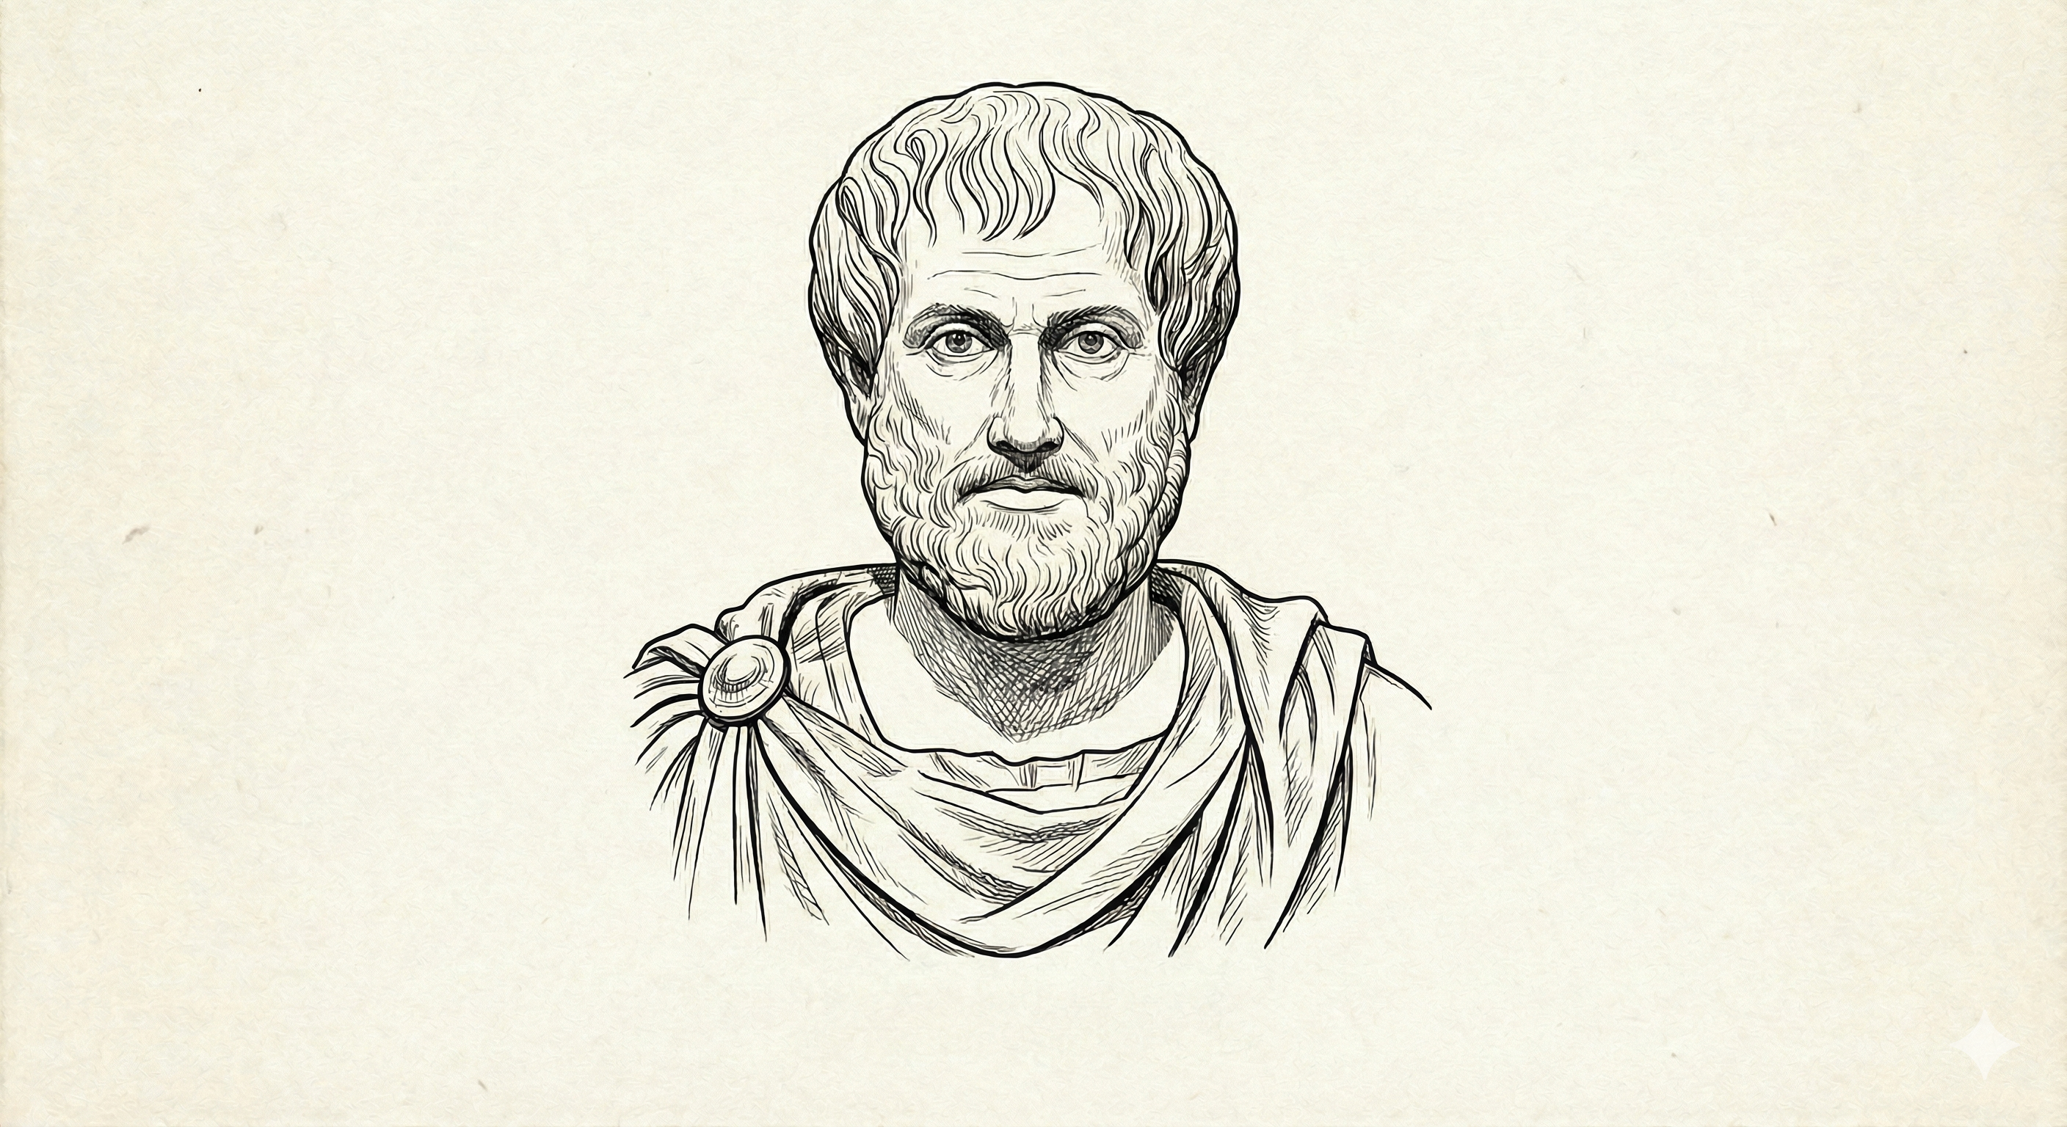
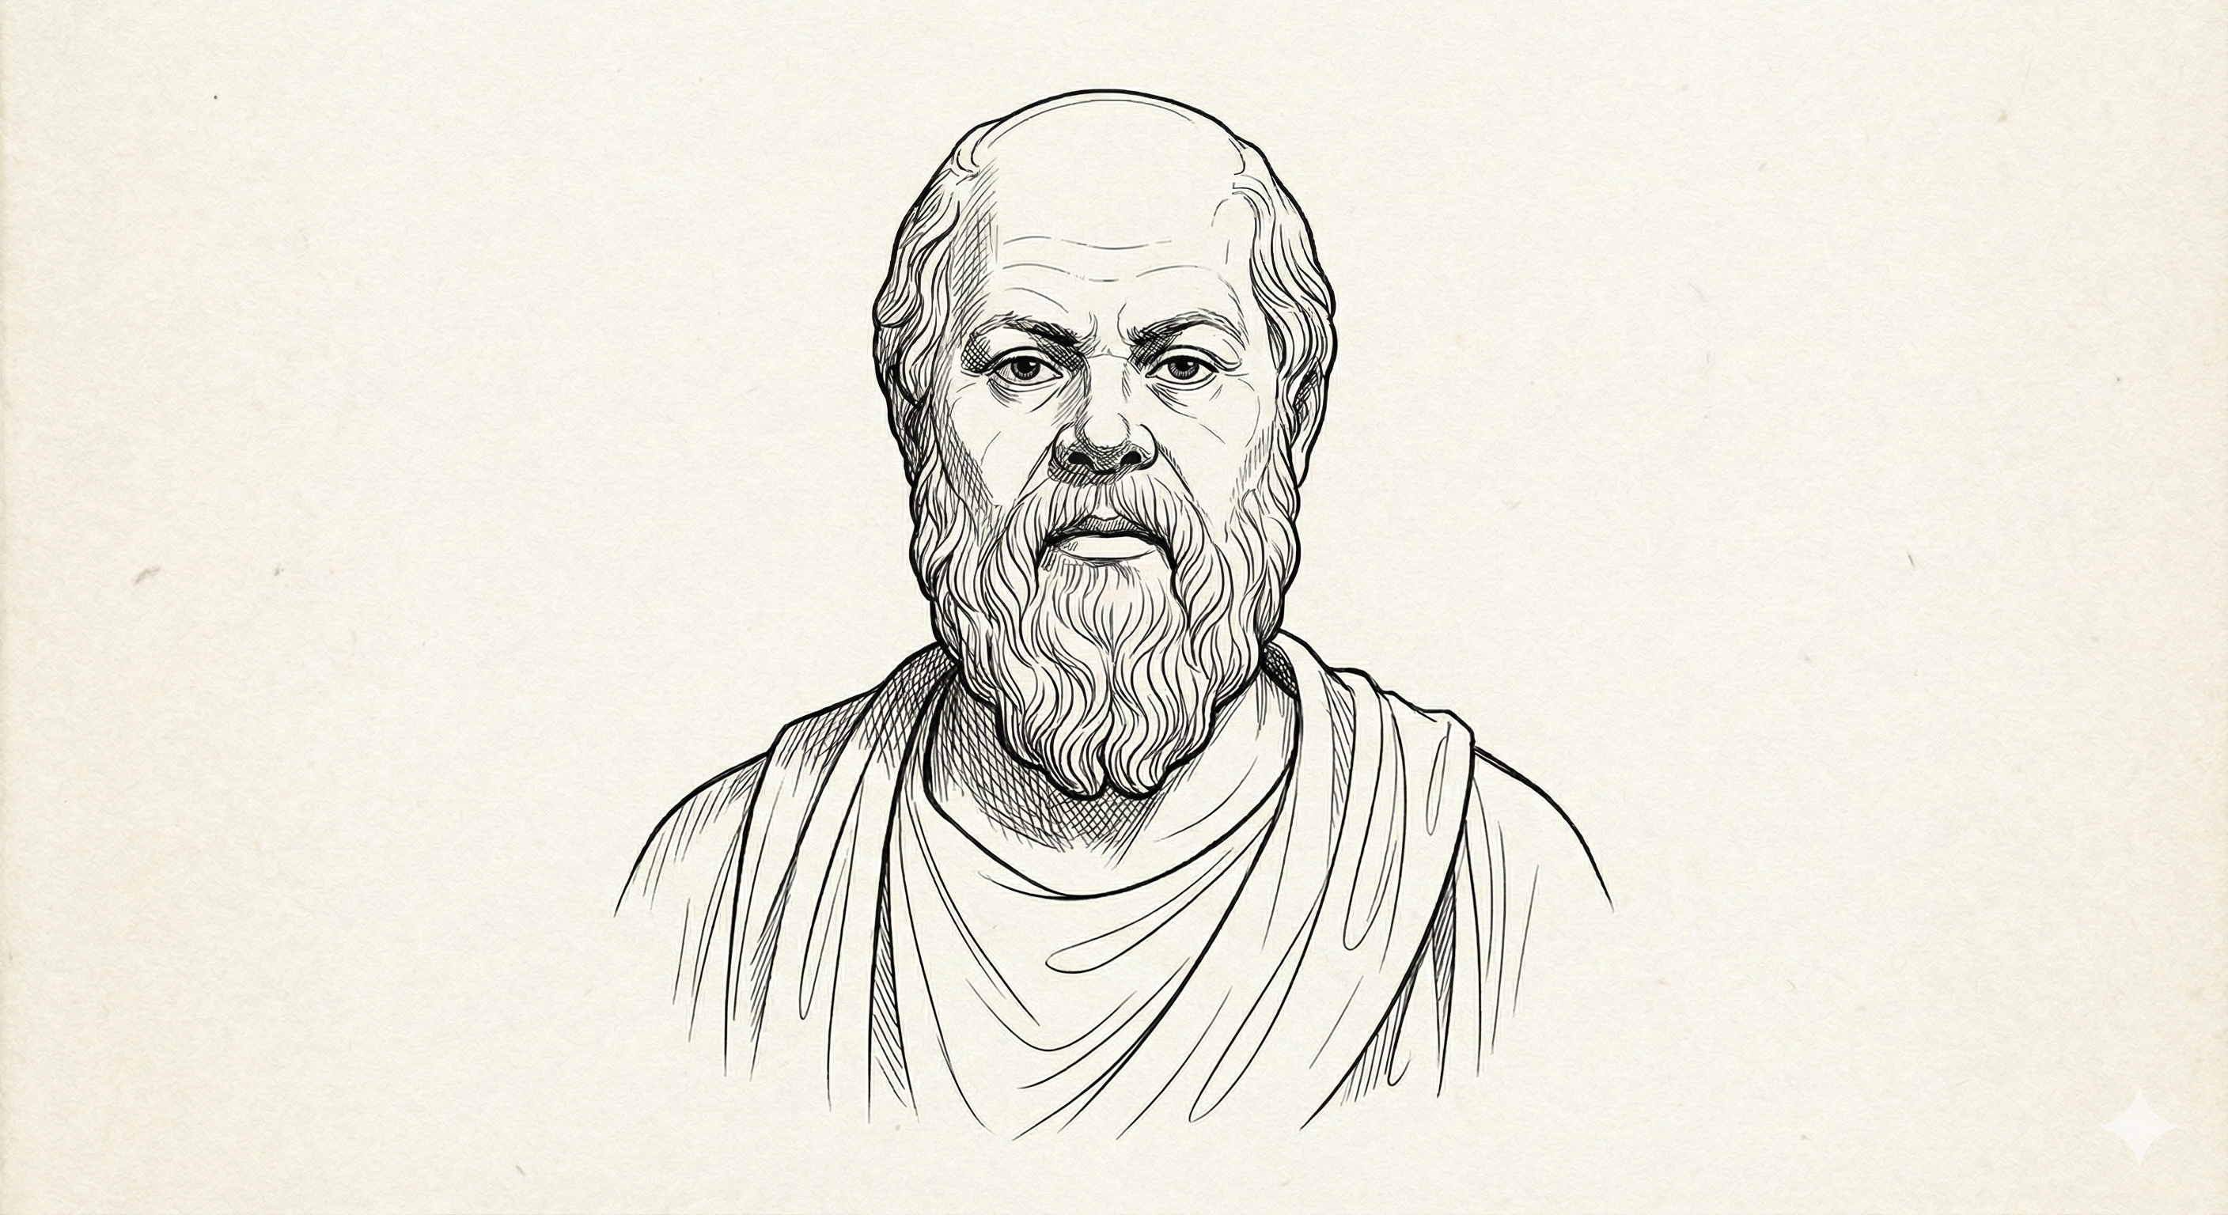
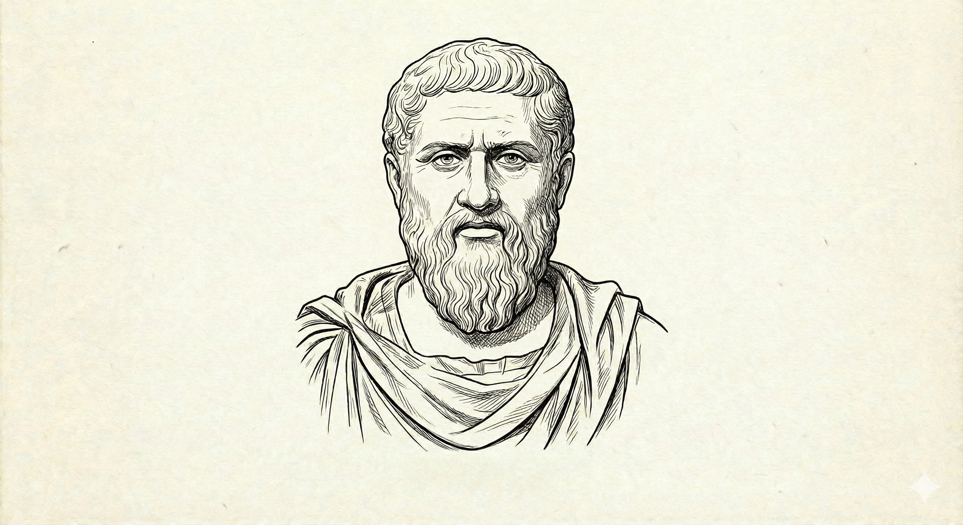
THE PHILOSOPHERS
Aristotle
The Empiricist
Analyzes systematically, focuses on logic, evidence, and categorization.
Socrates
The Questioner
Challenges assumptions, asks probing questions, promotes critical thought.
Plato
The Idealist
Seeks ideal forms, metaphysical truths, and moral dimensions.
https://github.com/mayurmadnani/multi-agent-debate

Slide 27

Thank You!!
https://linkedin.com/in/mayurmadnani

